Slide 1

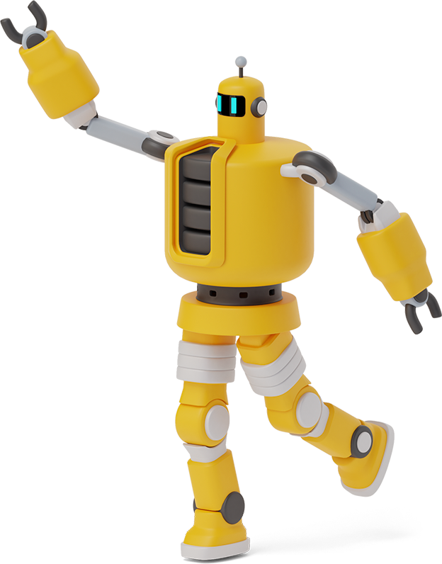
Detection of Breast Cancer Ffe Batch-2 Group-12

Slide 2

Agenda
01
Problem Statement
Our Notion & Our Execution
02
Roadmap
03
Website Demo
04
Conclusion

Slide 3
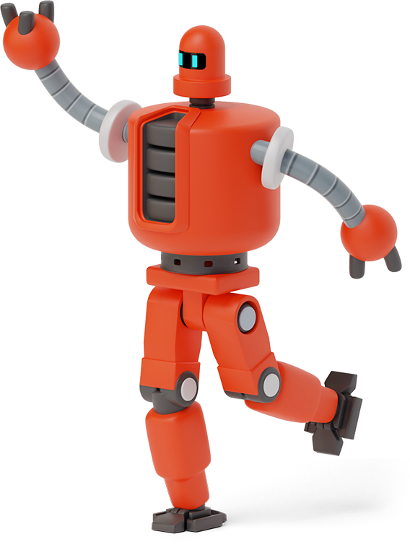
Problem Statement
1
We aim to predict the malignant or benign breast cancer by observing the previous records of the mammography diagnosis.

Slide 4

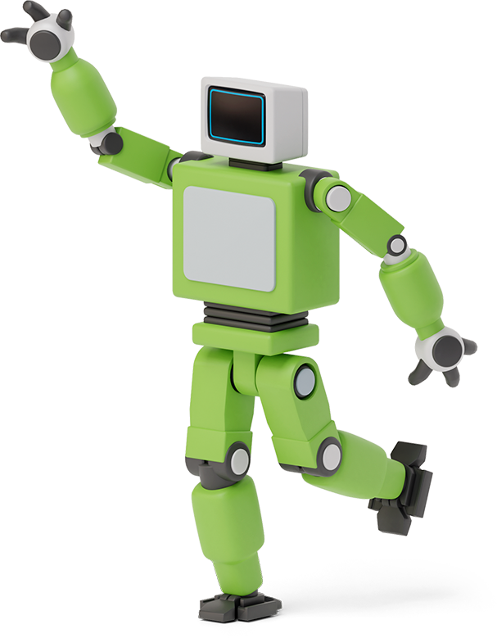

Our Notion
Breast cancer is basically is of two types Malignant and Benign.
Malignant is the variant where cancer spreads throughout whereas
Benign is the one which doesn't spread. Actually they doesn't have any intermediate values so we used classification to get the end product.
User : Cancer Patients & Doctors

Slide 5

Our Execution
We have taken up the dataset from UCI which contains the data of the 10 categories and up-to 30 inputs which are used to predict the type of cancer.
We have gone to talk with Medical graduate about the efficient way of taking up the 30 inputs.

Slide 6



DATASET ANALYSIS
 | Mean | Std. Deviation | Worst | Accuracy
Radius |  |  |  | 94.286
Texture |  |  |  | 78.571
Perimeter |  |  |  | 94.286
Area |  |  |  | 95.0
Smoothness |  |  |  | 82.857
Compactness |  |  |  | 87.857
Concavity |  |  |  | 94.286
Concave Points |  |  |  | 95.714
Symmetry |  |  |  | 80.714
Fractional Dimension |  |  |  | 82.143
Top 5 < Advised 4
* Chosen dataset does not contain any missing values

Slide 7
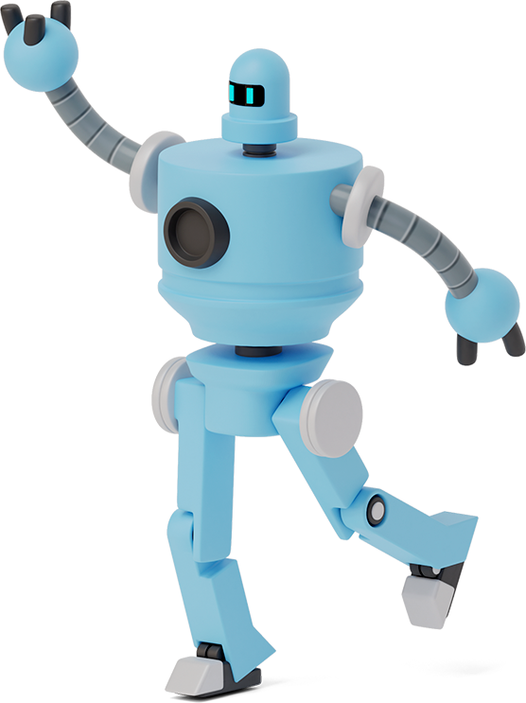

10 → 4
30 → 12
99.286%
Real-Valued Features
Inputs
Accuracy

Slide 8




PLANNING
A brief planning or insight of the project
DATA ACQUISITION
We have got the breast cancer dataset from UCI Machine Learning Repository.
MODEL DESIGN
Used various classification models (SVM,KNN)
MODEL TESTING
Tested different models
with test dataset.
MODEL SELECTION
We have coded a program to test different models. Got the confusion matrix & accuracy percentages of every respective models)

Slide 9
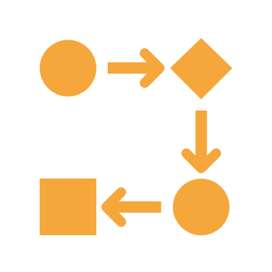


TRY TO PREDICT!
Dynamically we calculate accuracy of each model and Implements the model with highest accuracy for prediction.
INTERFACE PROCESS
Django framework is used to provide GUI.
Code & Demo
TECHNOLOGIES
Python
HTML & CSS
JavaScript
LIBRARIES
Scikit learn
Pandas & Numpy
Google Charts
RESOURCES
Kaggle
YouTube & Stack overflow
GeekforGeeks & w3schools

Slide 10

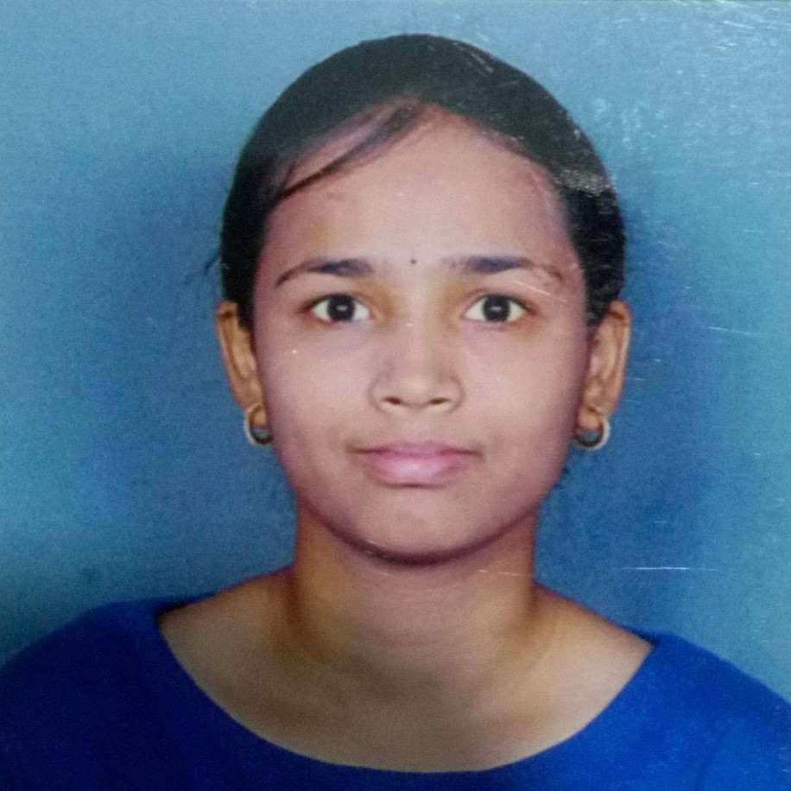
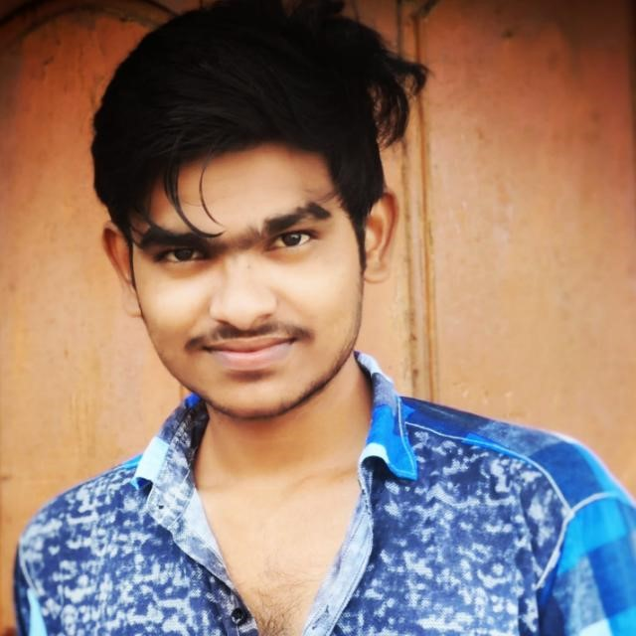
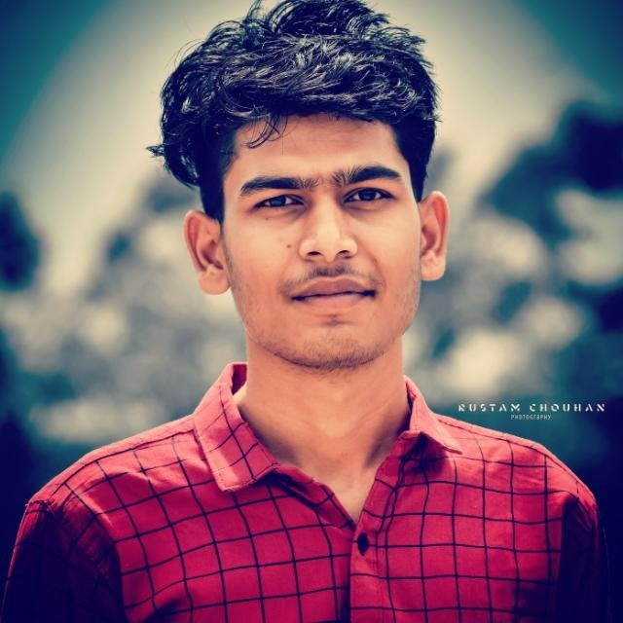
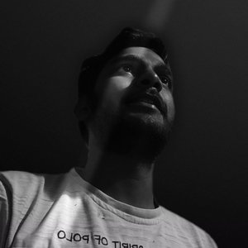
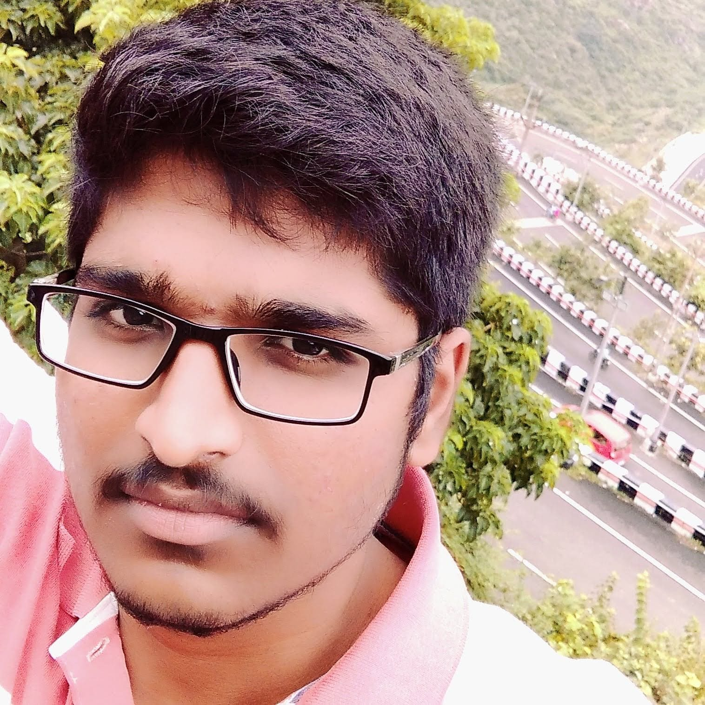
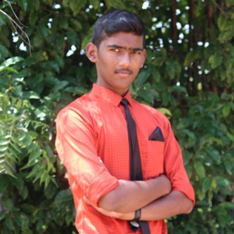

Our Team
Hari Bhoopala Krishnan MENTOR
DEEPTHI REDDY FFEUID036120
JAYANTH
FFEUID036257
MOHIT CHOUHAN FFEUID036578
NIRVAN REDDY FFEUID039728
PAVAN KUMAR FFEUID035293
PRANAY KUMAR FFEUID039107
TEAM LEADER
VARUN REDDY FFEUID040031

Slide 11
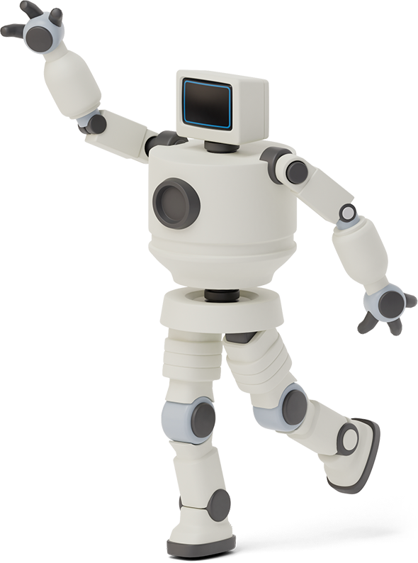

CONCLUSION
https://ffe212.herokuapp.com
We see this project as a small step to help cancer patients. It also gave us an experience in numerous fields.

Slide 12
Thank You FFE, Skill Build, IBM, Haribhoopala Krishnan some inspirations led us to this interface.
Thanks!
Any feedbacks?
“You should have even made the choosing of categories in dynamic way. As, even that trends may change”
- B Taruni (SDE at L&T infotech)

